Slide 1

University Institute of Engineering
DEPARTMENT OF COMPUTER SCIENCE & ENGINEERING
Bachelor of Engineering (Computer Science & Engineering)
Subject Name : Machine Learning
Subject Code: CST-316
Topic: Unsupervised Learning-Clustering (CO2)
Lecture-3.0
DISCOVER . LEARN . EMPOWER

Slide 2
Course Outcomes
CO-1:Apply the basic concept of Machine learning and statistics learning to deal with real-life Problems.
CO-2: Understand different machine learning algorithms, as well as underlying theories the behind them.
CO-3: Select and apply the appropriate machine learning algorithm to solve problems of moderate complexity
CO-4: Interpret and evaluate models generated from data.
CO-5: Optimize the models learned and report on the expected accuracy that can be attained by applying the algorithms to a real-world problem.

Slide 3
Course Objectives
To understand the history and development of Machine Learning.
To provide a comprehensive foundation to Machine Learning and Optimization methodology with applications t.
To study learning processes: supervised and unsupervised, deterministic and statistical knowledge of Machine learners, and ensemble learning
To understand modern techniques and practical trends of Machine learning.

Slide 4
Clustering
Clustering is a technique for finding similarity groups in data, called clusters. I.e.,
it groups data instances that are similar to (near) each other in one cluster and data instances that are very different (far away) from each other into different clusters.
Clustering is often called an unsupervised learning task as no class values denoting an a priori grouping of the data instances are given, which is the case in supervised learning.
Due to historical reasons, clustering is often considered synonymous with unsupervised learning.
In fact, association rule mining is also unsupervised
This chapter focuses on clustering.

Slide 5
Clustering
Clustering is a mode of unsupervised learning.
Given a collection of data points, the goal is to find structure in the data: organize that data into sensible groups.
We are after a convenient and valid organization of the data, not after a rule for separating future data into categories.
Cluster analysis is the formal study of algorithms and methods for doing that.
How many are there ?

Slide 6
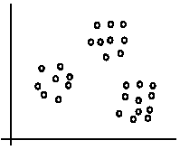
An illustration
The data set has three natural groups of data points, i.e., 3 natural clusters.

Slide 7
What is clustering for?
Let us see some real-life examples
Example 1: groups people of similar sizes together to make “small”, “medium” and “large” T-Shirts.
Tailor-made for each person: too expensive
One-size-fits-all: does not fit all.
Example 2: In marketing, segment customers according to their similarities
To do targeted marketing.

Slide 8
What is clustering for? (cont…)
Example 3: Given a collection of text documents, we want to organize them according to their content similarities,
To produce a topic hierarchy
In fact, clustering is one of the most utilized data mining techniques.
It has a long history, and used in almost every field, e.g., medicine, psychology, botany, sociology, biology, archeology, marketing, insurance, libraries, etc.
In recent years, due to the rapid increase of online documents, text clustering becomes important.

Slide 9
Classification vs. Clustering
Classification: Supervised learning: Learns a method for predicting the instance class from pre-labeled (classified) instances

Slide 10
Clustering
Unsupervised learning:
Finds “natural” grouping of instances given un-labeled data

Slide 11
What is Cluster Analysis?
Finding groups of objects such that the objects in a group will be similar (or related) to one another and different from (or unrelated to) the objects in other groups
Inter-cluster distances are maximized
Intra-cluster distances are minimized

Slide 12
Notion of a Cluster can be Ambiguous
How many clusters?
Six Clusters
Two Clusters
Four Clusters

Slide 13
Types of Clusters
Well-separated clusters
Center-based clusters
Contiguous clusters
Density-based clusters
Property or Conceptual
Described by an Objective Function

Slide 14
Types of Clusters: Well-Separated
Well-Separated Clusters:
A cluster is a set of points such that any point in a cluster is closer (or more similar) to every other point in the cluster than to any point not in the cluster.
3 well-separated clusters

Slide 15
Types of Clusters: Center-Based
Center-based
A cluster is a set of objects such that an object in a cluster is closer (more similar) to the “center” of a cluster, than to the center of any other cluster
The center of a cluster is often a centroid, the average of all the points in the cluster, or a medoid, the most “representative” point of a cluster
4 center-based clusters

Slide 16
Types of Clusters: Contiguity-Based
Contiguous Cluster (Nearest neighbor or Transitive)
A cluster is a set of points such that a point in a cluster is closer (or more similar) to one or more other points in the cluster than to any point not in the cluster.
8 contiguous clusters

Slide 17
Types of Clusters: Density-Based
Density-based
A cluster is a dense region of points, which is separated by low-density regions, from other regions of high density.
Used when the clusters are irregular or intertwined, and when noise and outliers are present.
6 density-based clusters

Slide 18
Types of Clusters: Conceptual Clusters
Shared Property or Conceptual Clusters
Finds clusters that share some common property or represent a particular concept.
2 Overlapping Circles

Slide 19
Types of Clustering
A clustering is a process to find a set of clusters
Important distinction between hierarchical and partitional sets of clusters
Partitional Clustering
A division data objects into non-overlapping subsets (clusters) such that each data object is in exactly one subset
Hierarchical clustering
A set of nested clusters organized as a hierarchical tree
Density based clustering
Discover clusters of arbitrary shape.
Clusters dense regions of objects separated by regions of low density

Slide 20
Partitional Clustering
Original Points
A Partitional Clustering

Slide 21
Hierarchical Clustering
Traditional Hierarchical Clustering
Traditional Dendrogram
Non-traditional Hierarchical Clustering
Non-traditional Dendrogram

Slide 22
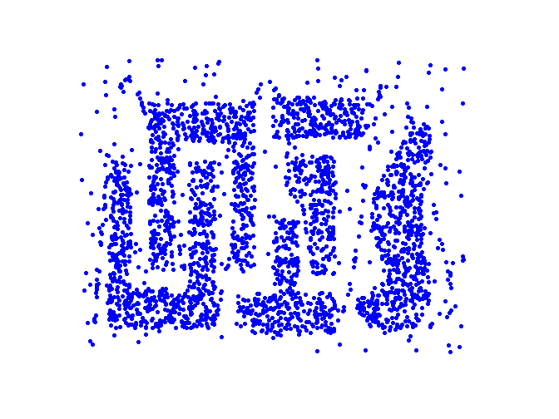
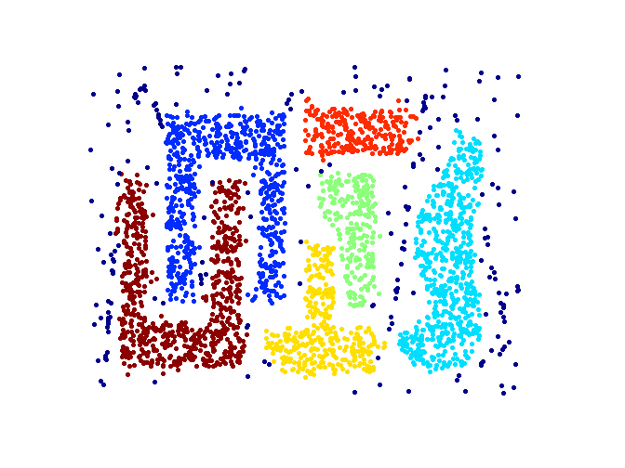
Density based Clustering
Original Points
Clusters

Slide 23
Aspects of clustering
A clustering algorithm
Partitional clustering
Hierarchical clustering
…
A distance (similarity, or dissimilarity) function
Clustering quality
Inter-clusters distance ⇒ maximized
Intra-clusters distance ⇒ minimized
The quality of a clustering result depends on the algorithm, the distance function, and the application.

Slide 24
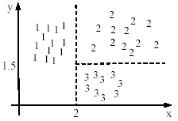

Using classification model
All the data points in a cluster are regarded to have the same class label, e.g., the cluster ID.
run a supervised learning algorithm on the data to find a classification model.

Slide 25
Types of Clustering Algorithms

Slide 26
References
Books and Journals
Understanding Machine Learning: From Theory to Algorithms by Shai Shalev-Shwartz and Shai Ben-David-Cambridge University Press 2014
Introduction to machine Learning – the Wikipedia Guide by Osman Omer.
Video Link-
https://www.youtube.com/watch?v=7Vfra2UDho0
https://www.youtube.com/watch?v=KYH7AlM2FYE
Web Link-
https://en.wikipedia.org/wiki/Cluster_analysis
https://www.datanovia.com/en/blog/types-of-clustering-methods-overview-and-quick-start-r-code/
https://www.geeksforgeeks.org/clustering-in-machine-learning/

Slide 27
THANK YOU

